Slide 1
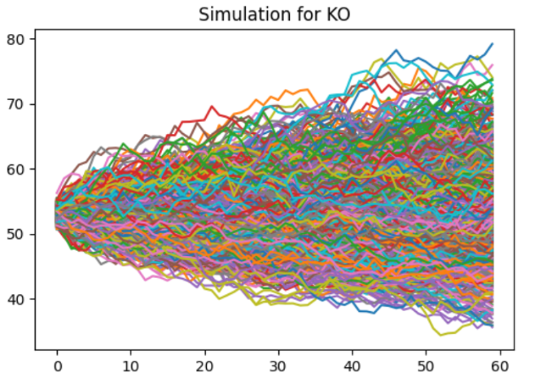
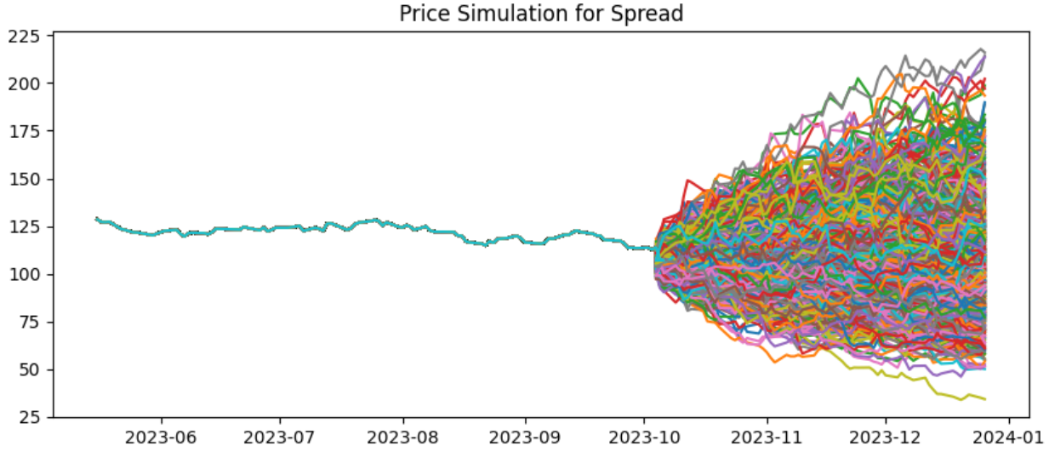
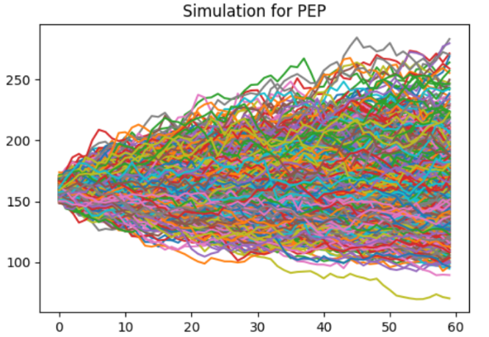
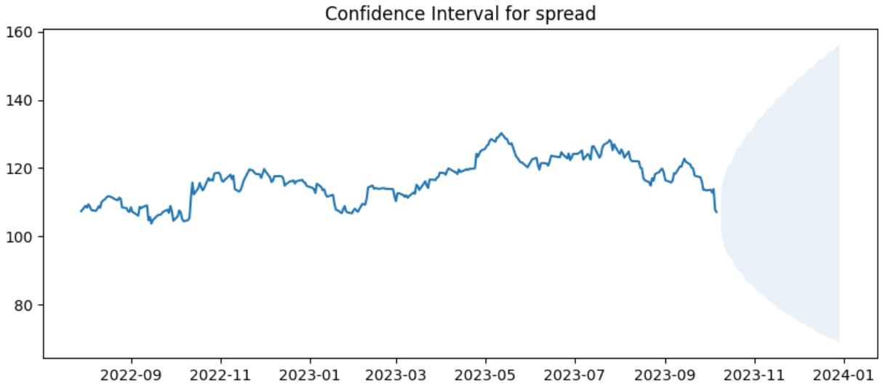
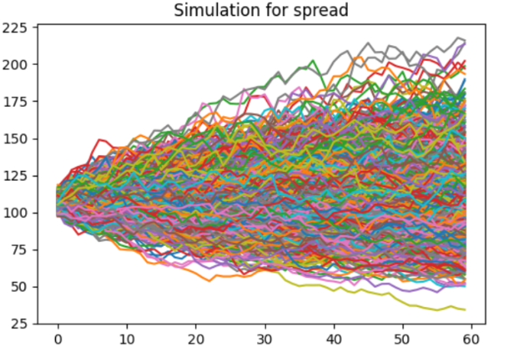
Simulation with Correlated Geometric Brownian Motion
GBM Simulation
Assumption:
1. Both stocks follow GBM
2. Historical correlation between stocks remain stable.
3. We use yahoo finance, stock mu= Forward Dividend & Yield, sigma=option with closest strike price and expiration implied volatility.
We simulate GBM for KO and PEP, then use the result to calculate spread (PEP-KO). We then plot the result together with the historical data and then calculate and plot the 95% confidence interval

Slide 2
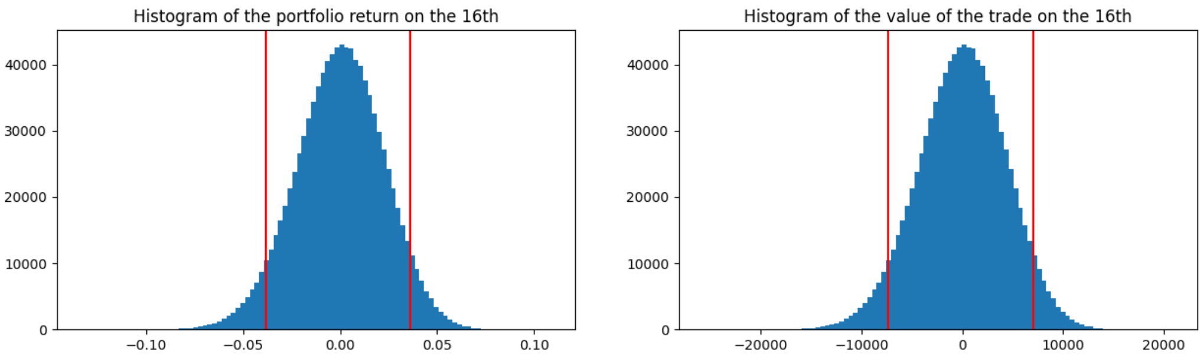
2. Pair Trading Strategy (Fixed)
At October 9th. We enter the spread by selling pepsi and buying coke. Assume 5% risk free rate:
Assumption: We can only buy stock in multiples of 100.
Position:
Short 600 PEP @ 160.28, 49.73% of our position
Long 1800 KO @ 53.139, 50.0% of our position
Holding Cash 521.99, 0.27% of our position
At October 16th:
Expected value of the trade on the 16th: 3.653
95th percentile P&L: 3.63%
5th percentile P&L: -3.81%

Slide 3
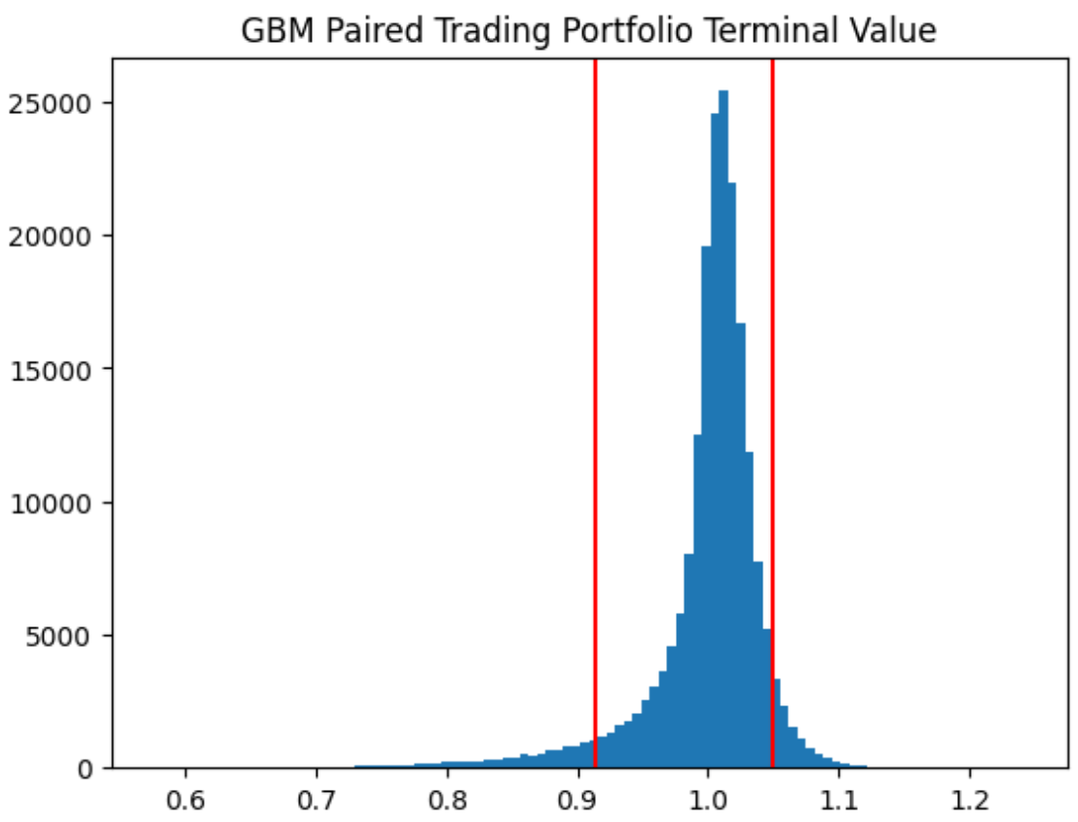
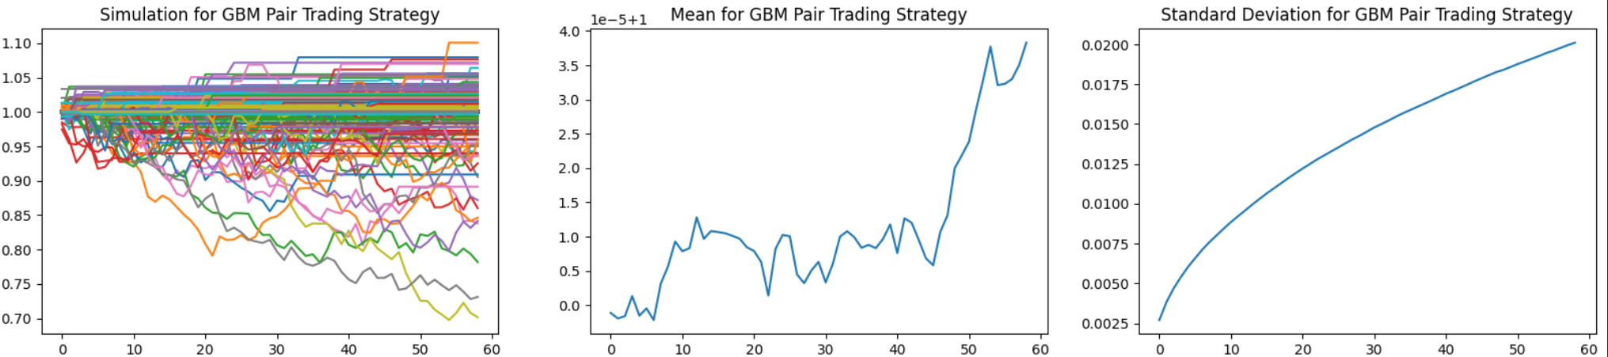
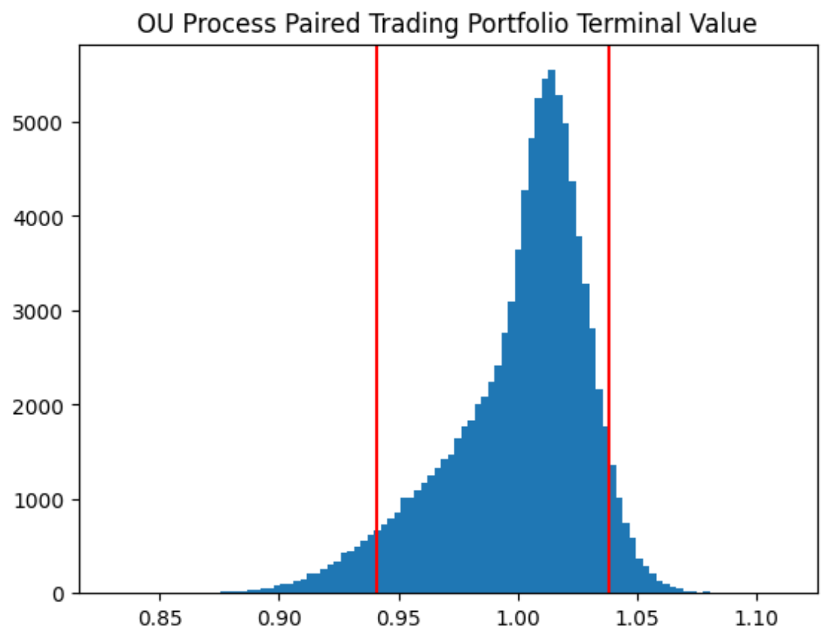
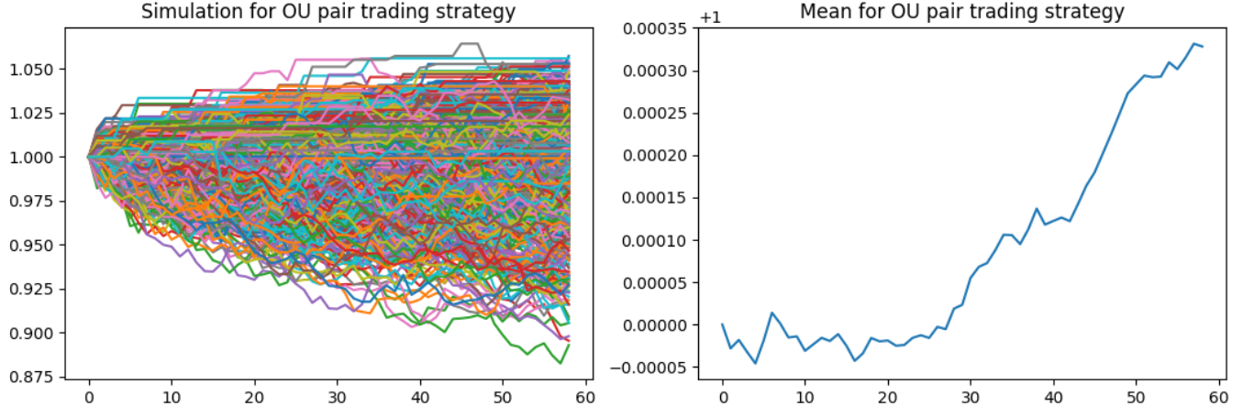
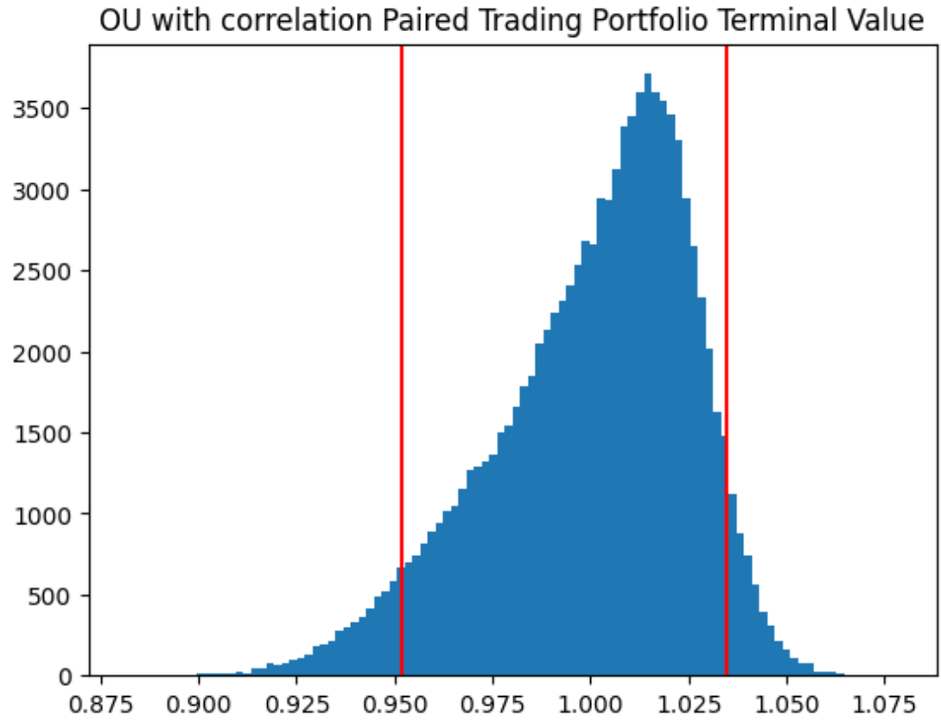
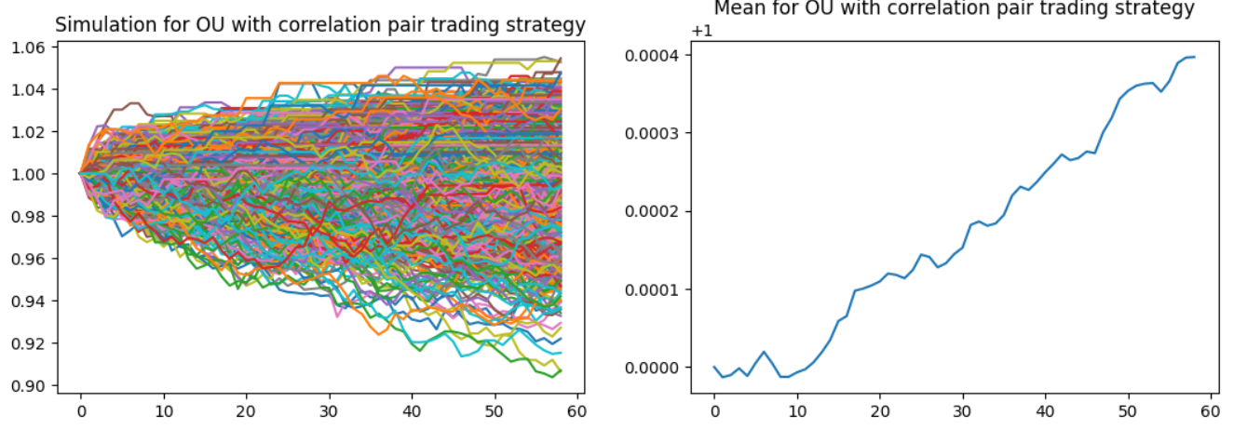
3. Paired Trading Strategy Entry and Exit
Strategy rules:
We simulate stock spread
If observed spread > 1-alpha percentile simulated spread: short spread (short PEP long KO)
observed spread < alpha percentile simulated spread: long spread (long PEP short KO)
Assumptions:
We assume we can place equal dollar amount of position on PEP and KO, whether long or short.
We ignore transaction cost, and we assume to take only three actions: long spread, 0, short spread. There is no increasing position, and we hold long/short spread until spread falls back into the alpha, 1-alpha range
We determine the profit maximizing alpha using simulation.
The investment horizon is 3 months (60 days)
3 spread simulation: GBM with correlation, Ornstein-Uhlenbeck process, Ornstein-Uhlenbeck with dW term correlated.
Expected terminal value (started from 1):
GBM+correlation: 1.000038287
OU: 1.0003280
OU+correlation: 1.0003965
Risk free: 1.012578
Risk free is higher than all spread model pair trading simulation. This result is expected under Efficient Market Hypothesis.
GBM with correlation, alpha = 0.0130
O-U process, alpha = 0.258
O-U process with correlation, alpha = 0.338

